Slide 1

Stage 9:
Song writing
http://efllecturer.blogspot.com.es/2014/05/talking-about-music-why-do-we-listen-to.html
What did we do last time?
What do you wish we had had a chance to do?
Did you think of any questions after the lesson that you want to ask?
What was your favorite part of the last lesson?

Slide 2
Objectives
Students will:
Locate repeating phrases inside song lyrics
Identify sections of a song to pull into a function (chorus)
Describe how functions can make programs easier to write

Slide 3
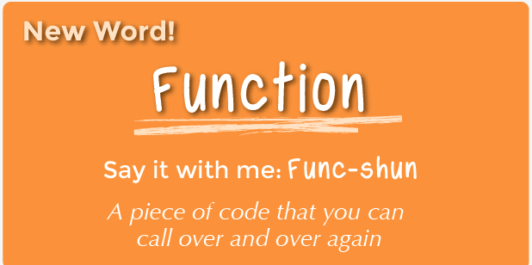
Vocabulary
Function - Say it with me: Func-shun
A piece of code that you can call over and over again

Slide 4
Video
https://studio.code.org/s/course3/stage/9/puzzle/1

Slide 5
Example
Sing this song.
Then, decide which parts can be made into functions.

Slide 6
Directions
Play the game over until everybody can identify the chorus. Here are some possible songs:
You Are My Sunshine
Boom, Boom, Ain't it Great
How Much Is That Doggie in the Window
I Love Trash

